Slide 1
Order Management Web Microservices Project
Hanane Maguer

Slide 2
About me
  Hanane Maguer
  Education:
    Bachelor Degree in computer sciences.
    Master Degree in computer sciences.
    Full Stack Software Developer training.
    MS-SQL database administration certificate.
  Work:
    Software Developer, BRPM.
    Software Developer, VILETE.
    SQL instructor, Alamia Private School.
    Technical support, TTEC.

Slide 3
Background
What is Order Managment?
  Order Management web application.
  Admin posts products.
  Customer displays products.
  Customer makes an order.
  Admin displays and manages orders from customers.
  Kafka Producer publish order event to order event topic on the broker.
  Kafka Consumer subscribe to order event topic and send email notification on successful order creation or cancellation to the customer.

Slide 4
Goals
Add users with credentials and roles to a database.
After login, each user will be forwarded to a specific principal web page based on her/his role.
Each role is allowed/restricted to/from actions.
Three main roles admin, user.

Slide 5
Entity Relationships

Slide 6
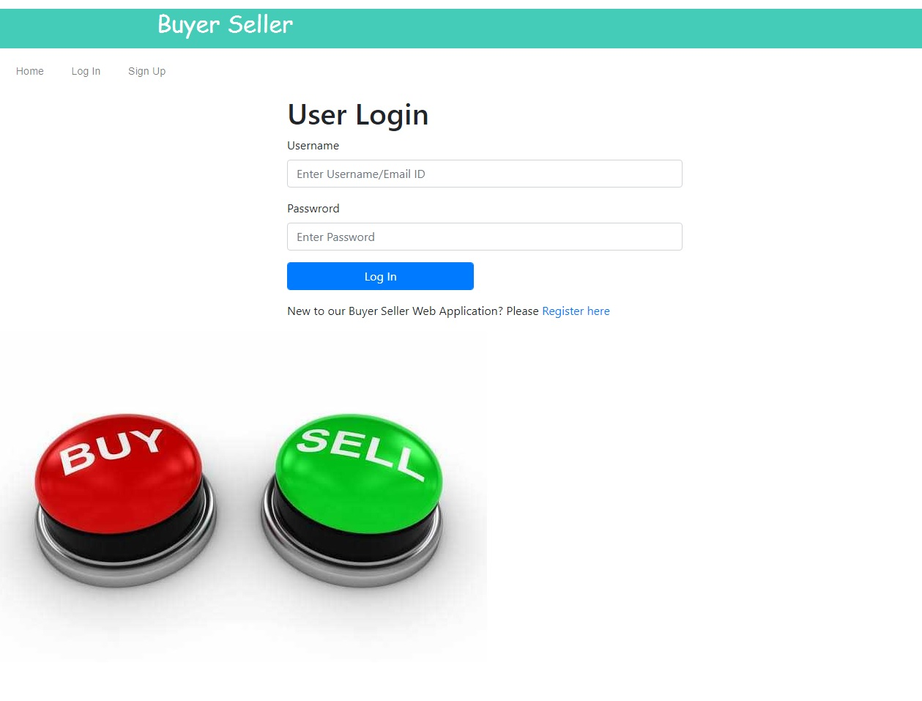
Functionality
Main goal was to create users with specific roles to track user information ex: user id.
Application principal page with login/registration options.
Three sub-principal pages: admin page, seller page and buyer page.

Slide 7
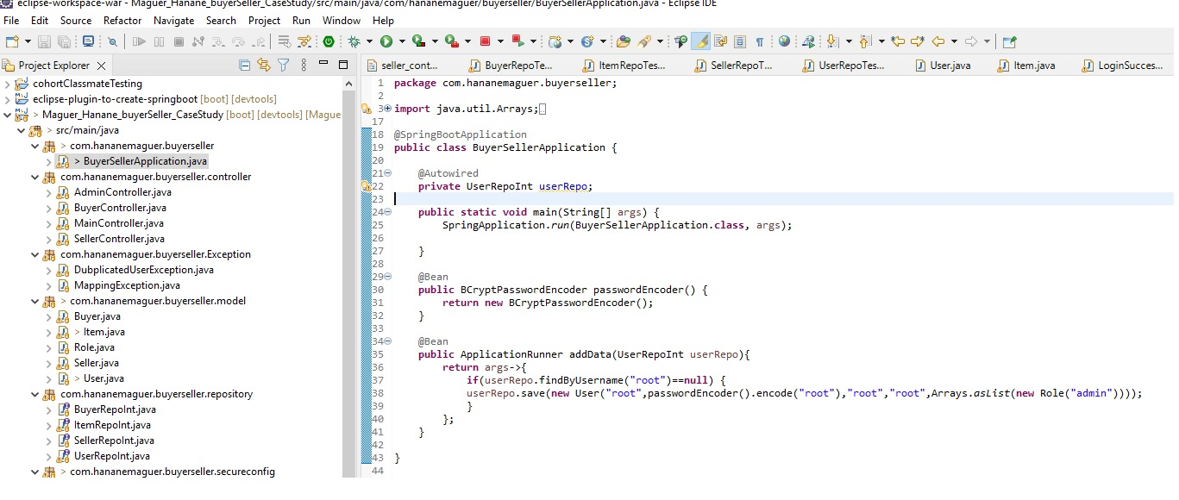
Functionality/default user
Default admin user with “root” username and “root” password.

Slide 8
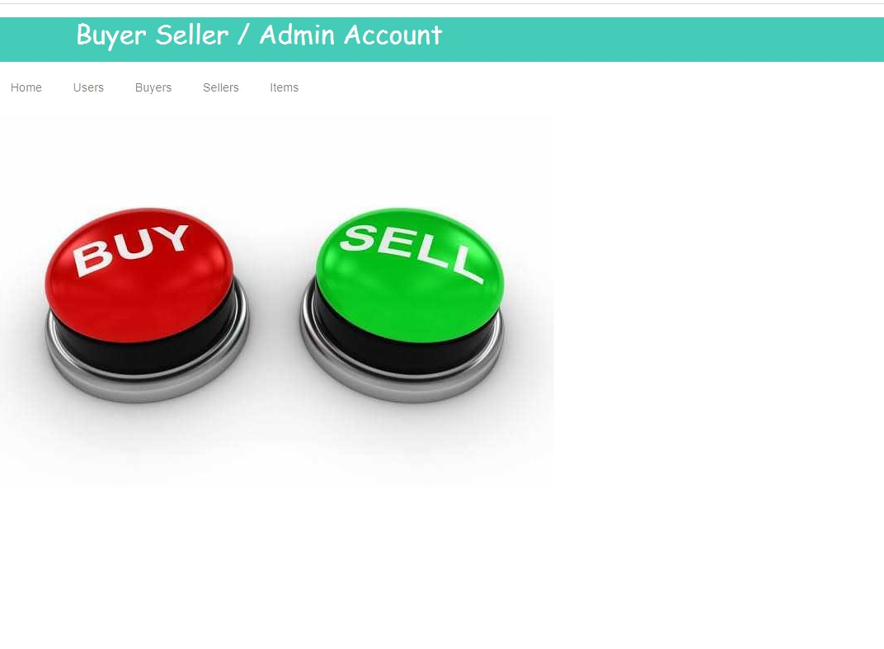
Functionality/Admin page
This page used by an admin to
add, delete, modify, and list :
  Users
  Products
  Orders
  Customers

Slide 9
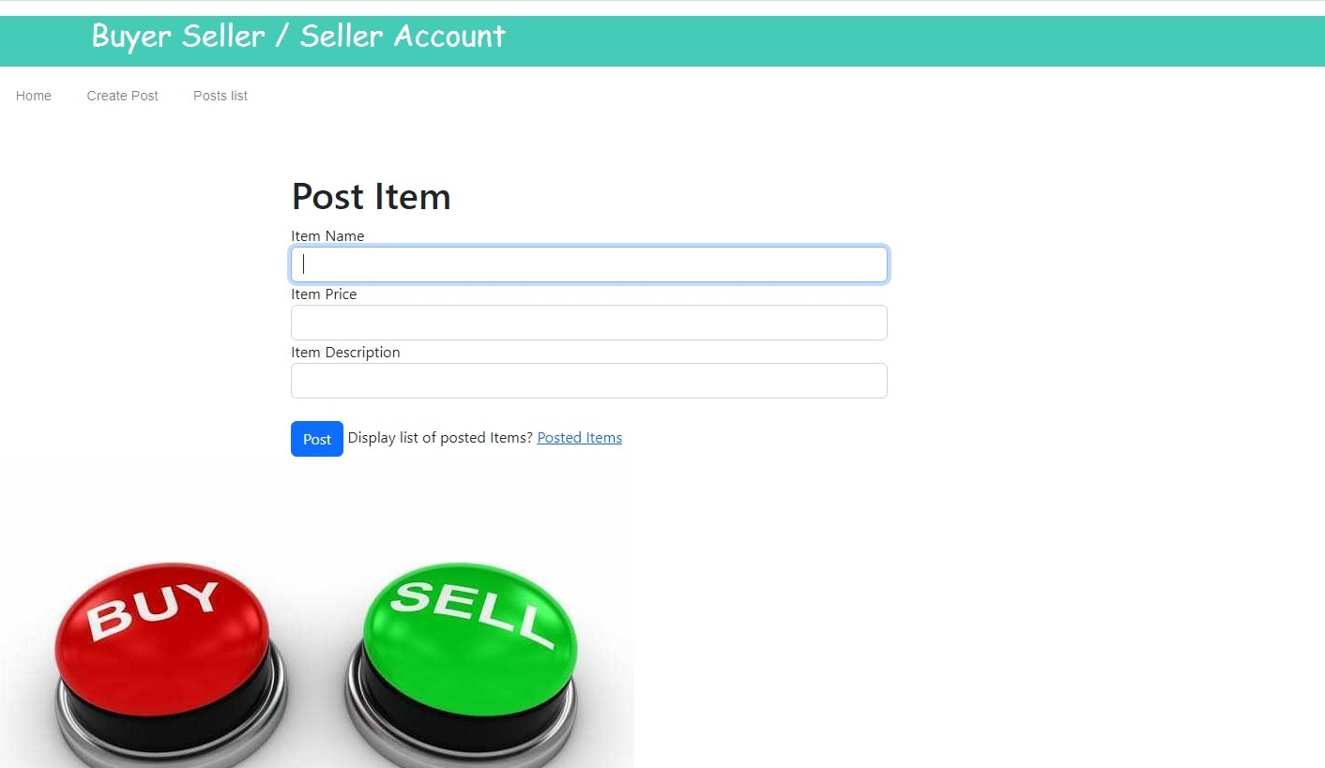
Functionality/Seller page
This page used by a seller to add, modify, delete and list :
  Her/his Posted Items.

Slide 10
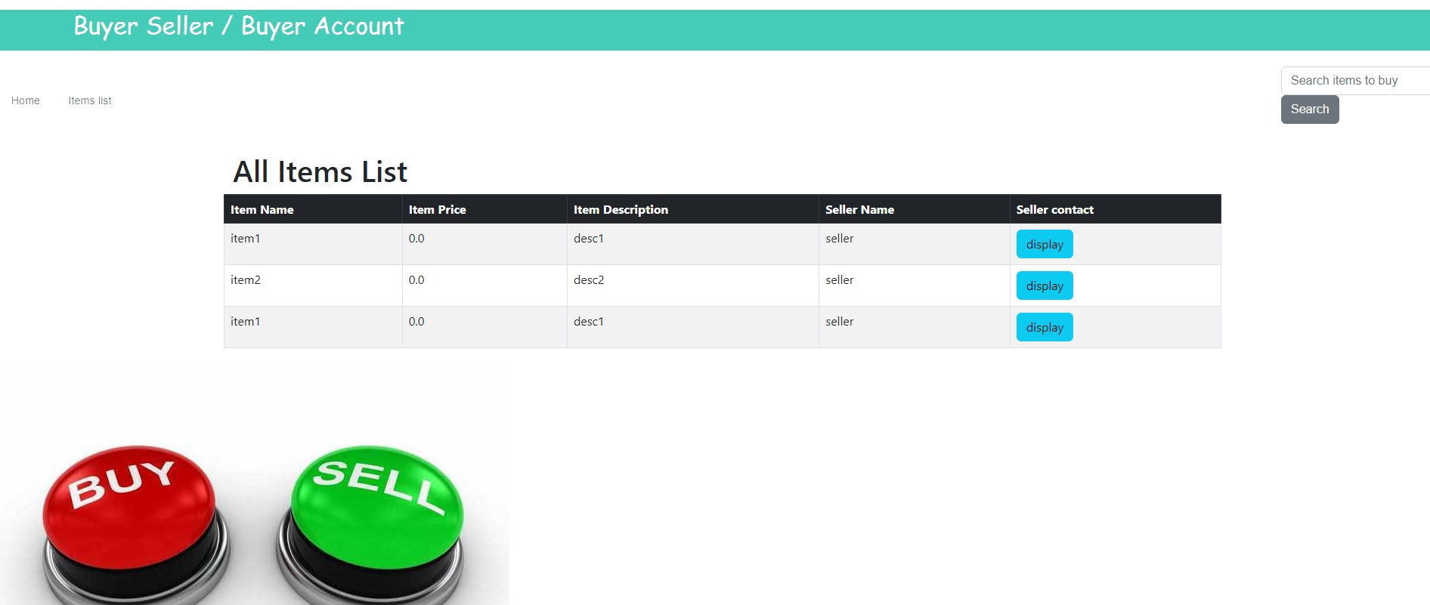
Functionality/Buyer page
This page used by a buyer to list and search for :
  Items
  Display seller contact information.

Slide 11
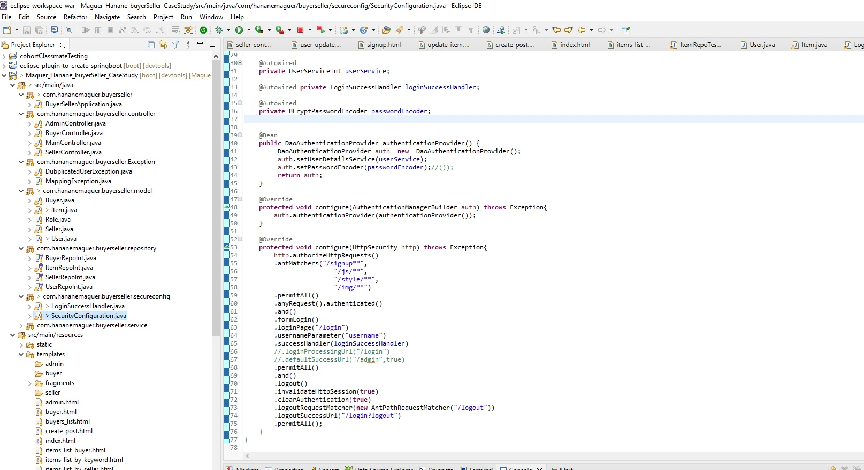
Project Structure

Slide 12
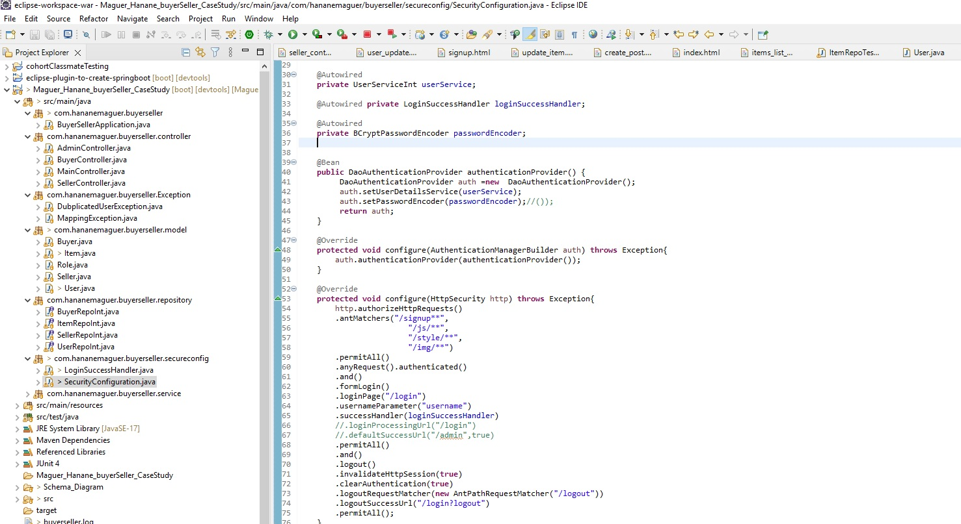
Challenges
Security

Slide 13
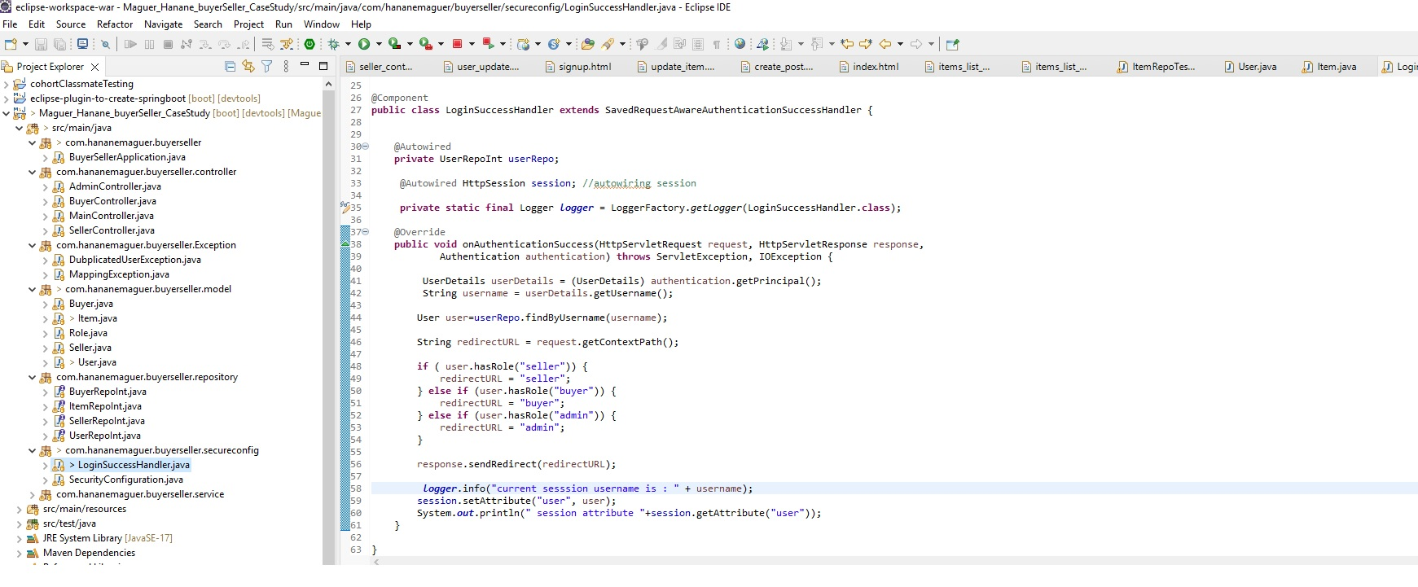
Challenges
Security /based on Roles

Slide 14











Used technologies

Slide 15
What’s next
Allowed seller to upload item’s image.
Display items images in the application’s main page with sliding option.
Add online secure payment.

Slide 16
Questions?

